Slide 1
EMOTION IN WORDS
TEXT PROCESSING

Slide 2
CONTENTS
01
02
OBJECTIVE
ABSTRACT
03
04
IMPLEMENTATION OF DATASET GENERATION
ARCHITECTURE DIAGRAM & FLOW CHART

Slide 3
OBJECTIVE
1.The objective of our project is to extract text from an image
2. Classifying the emotion in the text
3. Creating an APP for deployment of our project

Slide 4
ABSTRACT
In machine learning, the detection of textual emotions is the problem of content-based classification, which is the task of natural language processing. Detecting a person’s emotions is a difficult task, but detecting the emotions using text written by a person is even more difficult as a human can express his emotions in any form. Usually, emotions are expressed as joy, sadness, anger, surprise, hate, fear, etc. Recognizing this type of emotion from a text written by a person plays an important role in applications such as chatbots, customer support forum, customer reviews etc. This is our NLP project on Text Emotions Detection using Python where we will build a machine learning model to classify the emotions of a text. For detecting emotions from the text, we will perform a few steps that will start with preparing the data. Then the next step will be tokenization where the textual data will be converted into tokens and from these tokens, we have to identify the emotional words.
These emotional words will be the keyword to classify the emotions of a text. Next, we’ll frame this task in such a way that a text will be taken as an input and the emoji that represents the emotions in that text is generated as the output in the API that we have created using streamlit in Python

Slide 5
OUR PATHWAY
01
02
03
04
DATA GATHERING
BUILDING AN API
DATA PROCESSING
DATA ANALYSIS
& EMOTION CLASSIFICATION

Slide 6
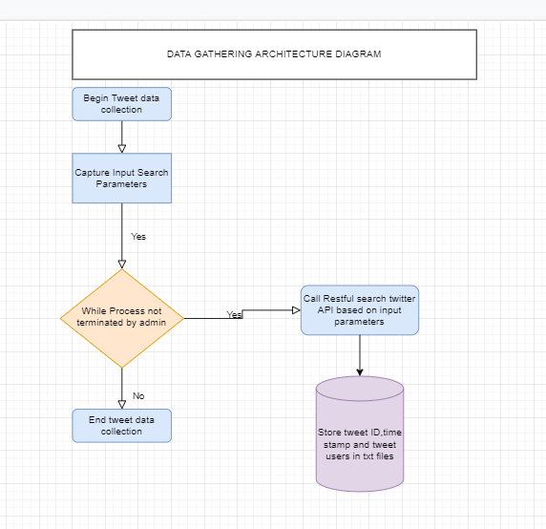

Slide 7
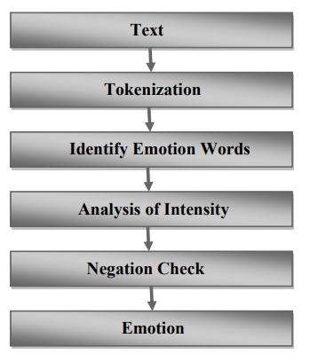

Slide 8
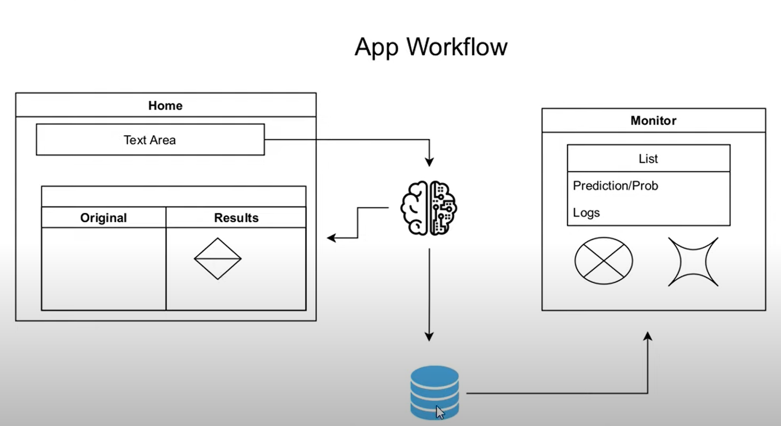

Slide 9
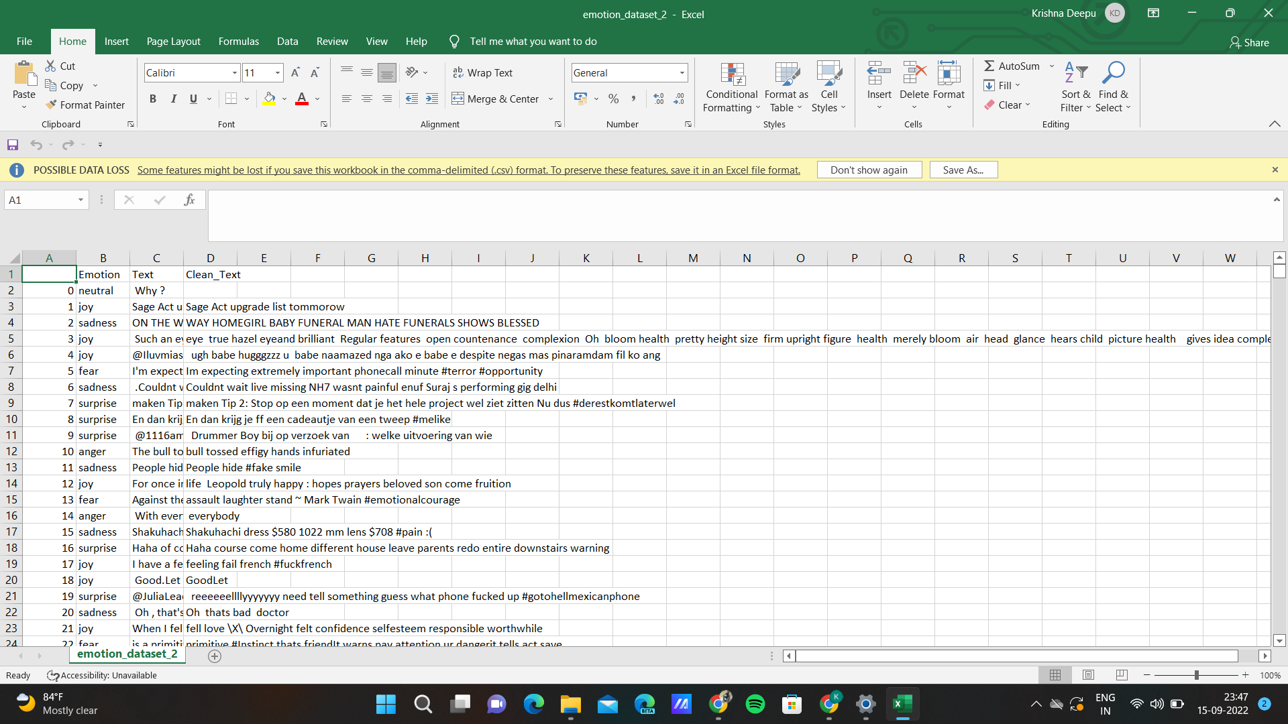
TRAINING DATASET

Slide 10
THANK YOU

